Slide 1
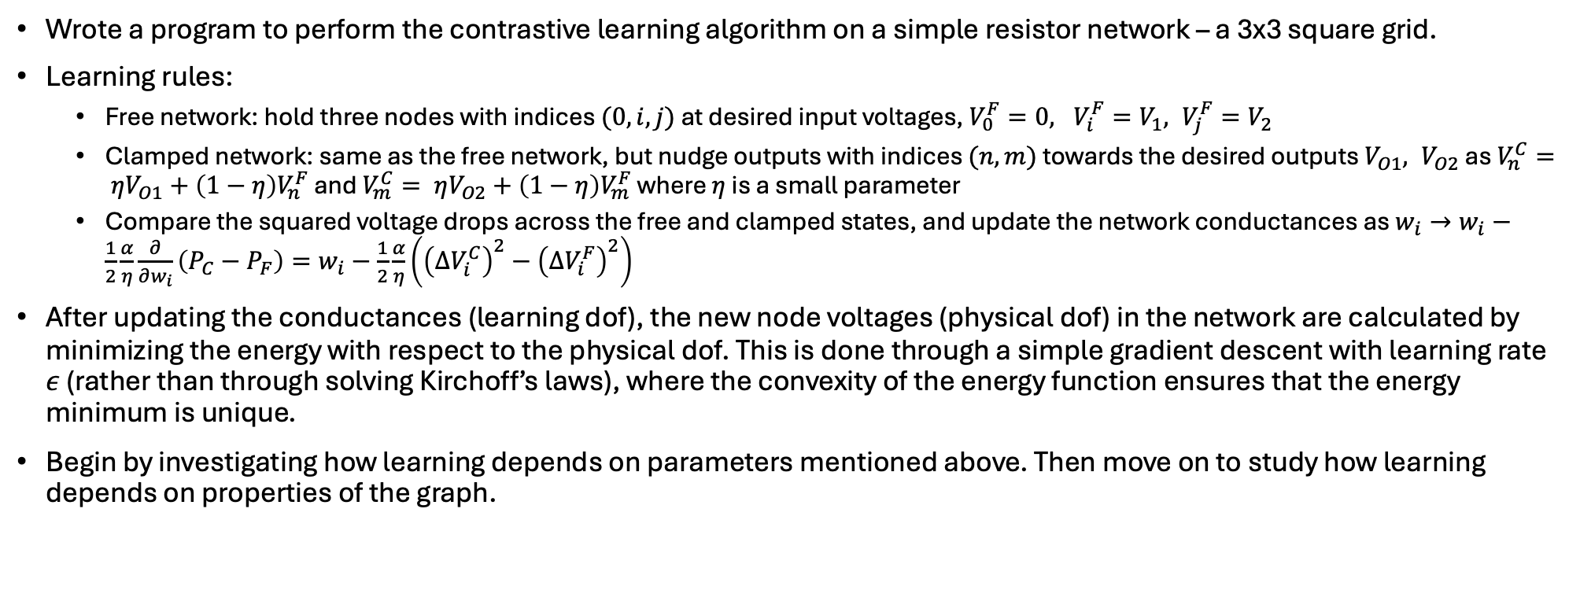
Contrastive learning – basic algorithm
Wrote a program to perform the contrastive learning algorithm on a simple resistor network – a 3x3 square grid.
Learning rules:
Free network: hold three nodes with indices $(0, i, j)$ at desired input voltages, $V_{0}^{F}=0, V_{i}^{F}=V_{1}, V_{j}^{F}=V_{2}$
Clamped network: same as the free network, but nudge outputs with indices $(n, m)$ towards the desired outputs $V_{O1}, V_{O2}$ as $V_{n}^{C}= ηV_{O1}+\left(1−η\right)V_{n}^{F}$ and $V_{m}^{C}= ηV_{O2}+\left(1−η\right)V_{m}^{F}$ where $η$ is a small parameter
Compare the squared voltage drops across the free and clamped states, and update the network conductances as $w_{i}→w_{i}−\frac{1}{2}\frac{α}{η}\frac{∂}{∂w_{i}}\left(P_{C}−P_{F}\right)=w_{i}−\frac{1}{2}\frac{α}{η}\left({\left(ΔV_{i}^{C}\right)}^{2}−{\left(ΔV_{i}^{F}\right)}^{2}\right)$
After updating the conductances (learning dof), the new node voltages (physical dof) in the network are calculated by minimizing the energy with respect to the physical dof. This is done through a simple gradient descent with learning rate $ε$ (rather than through solving Kirchoff’s laws), where the convexity of the energy function ensures that the energy minimum is unique.
Begin by investigating how learning depends on parameters mentioned above. Then move on to study how learning depends on properties of the graph.

Slide 2
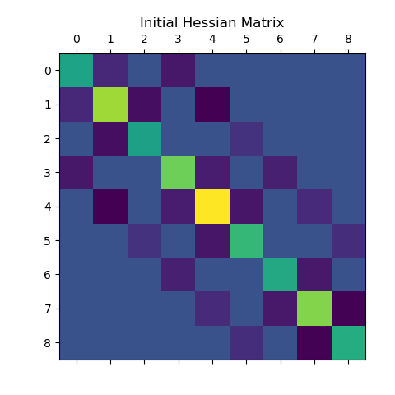
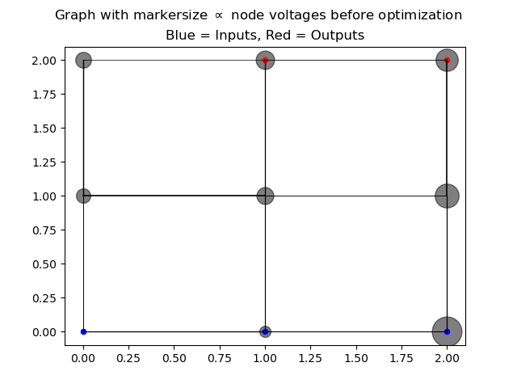
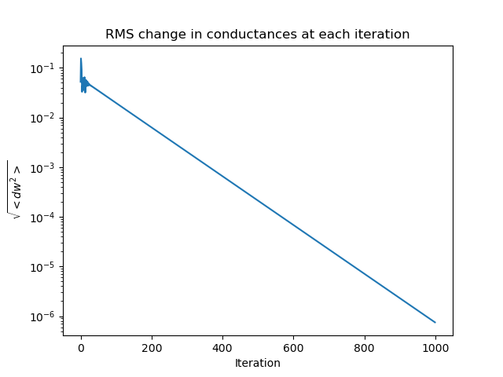
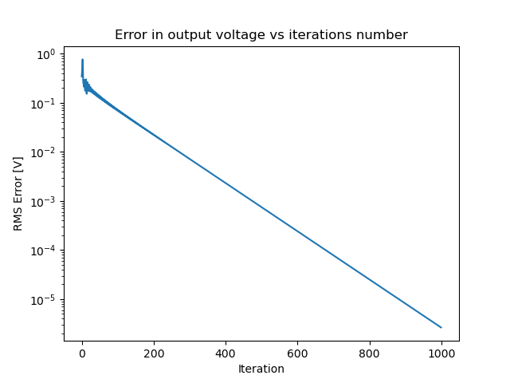
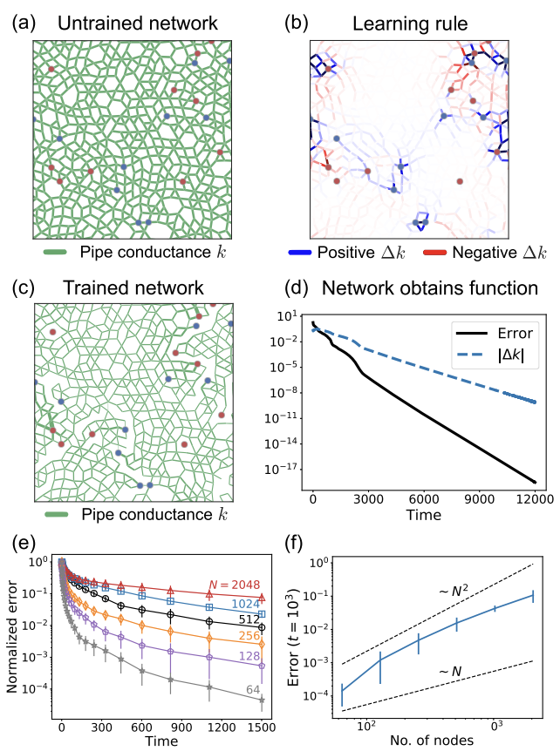
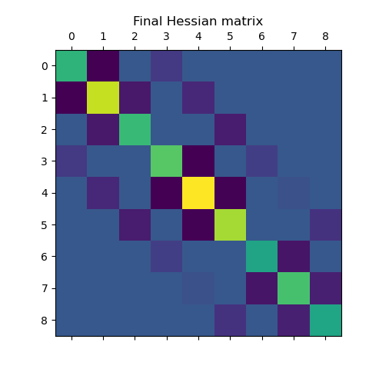
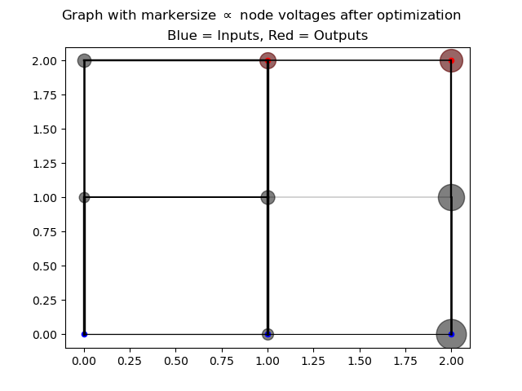
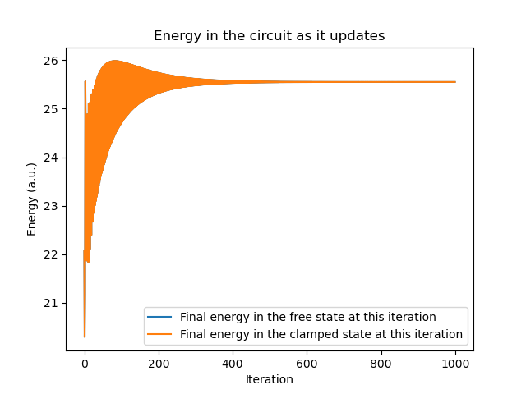
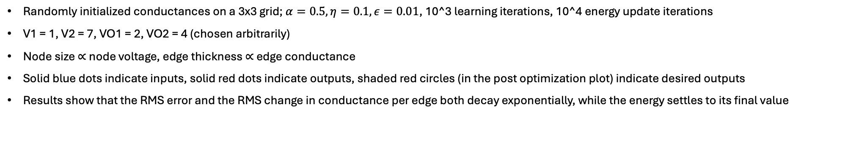
Contrastive learning – some sample results
Randomly initialized conductances on a 3x3 grid; $α=0.5, η=0.1, ε=0.01$, 10^3 learning iterations, 10^4 energy update iterations
V1 = 1, V2 = 7, VO1 = 2, VO2 = 4 (chosen arbitrarily)
Node size $∝$ node voltage, edge thickness $∝$ edge conductance
Solid blue dots indicate inputs, solid red dots indicate outputs, shaded red circles (in the post optimization plot) indicate desired outputs
Results show that the RMS error and the RMS change in conductance per edge both decay exponentially, while the energy settles to its final value
Compare to the results from Liu’s group:
Notes:
Saved as “Trial 1” in the contrastive learning folder

Slide 3
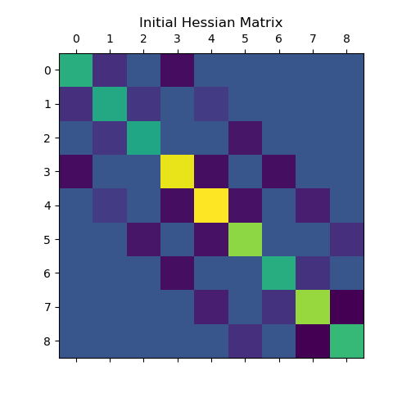
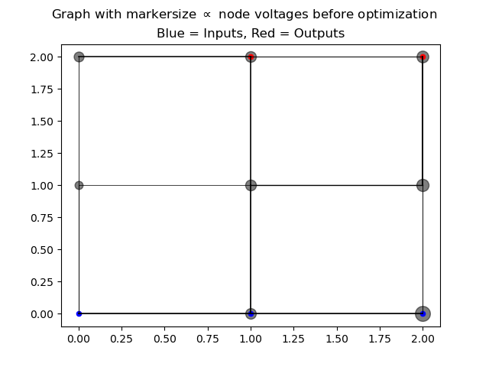
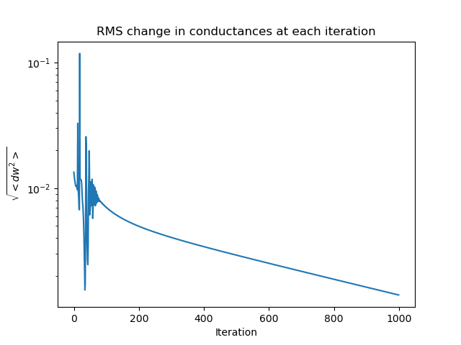
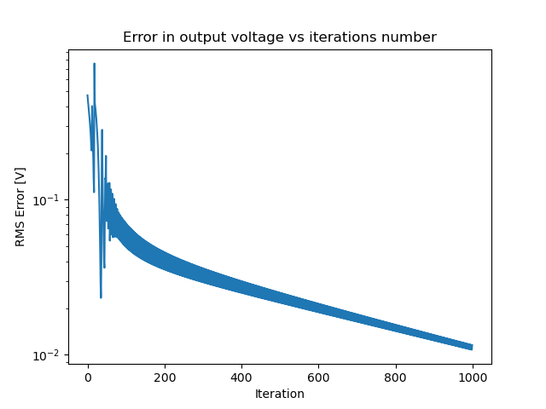
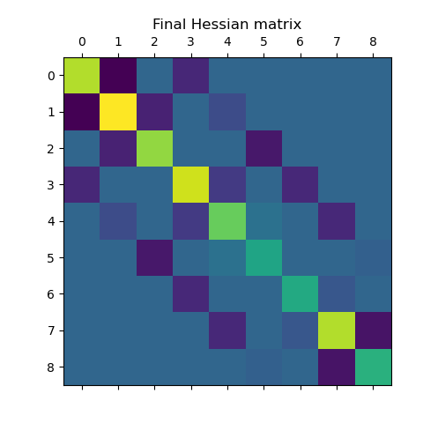
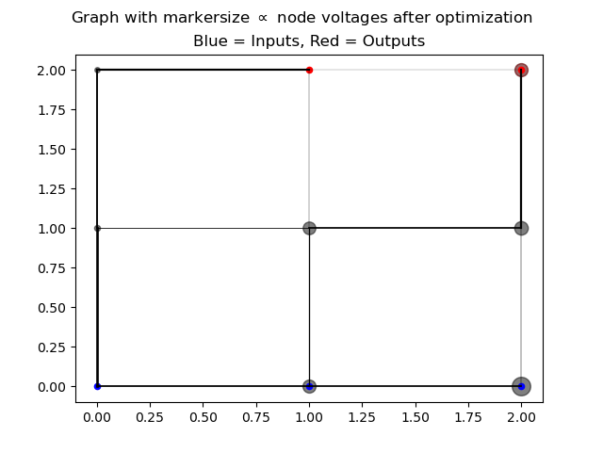
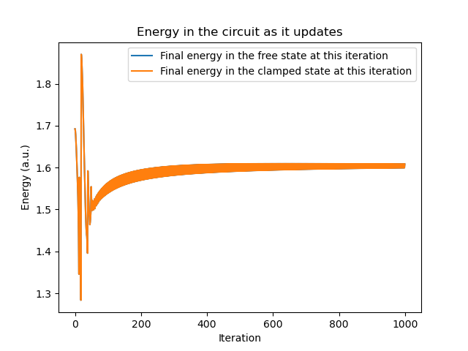
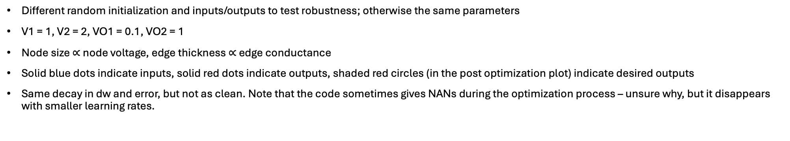
Contrastive learning – some sample results
Different random initialization and inputs/outputs to test robustness; otherwise the same parameters
V1 = 1, V2 = 2, VO1 = 0.1, VO2 = 1
Node size $∝$ node voltage, edge thickness $∝$ edge conductance
Solid blue dots indicate inputs, solid red dots indicate outputs, shaded red circles (in the post optimization plot) indicate desired outputs
Same decay in dw and error, but not as clean. Note that the code sometimes gives NANs during the optimization process – unsure why, but it disappears with smaller learning rates.
Notes:
Saved as “Trial 2” in the contrastive learning folder

Slide 4
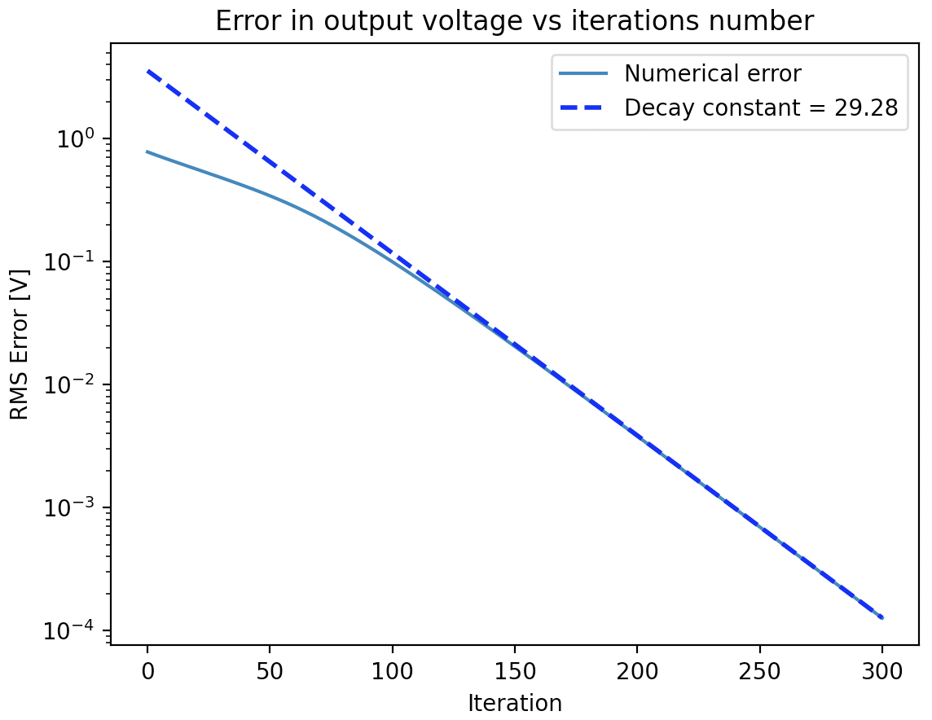
Contrastive learning – some qualitative tests
How does the optimum alpha and eta change with the number of learning degrees of freedom? First study the optimum alpha and eta for the previous network.
Determine the “optimum” as that which leads to the fastest learning; since it is exponential, fit to the latter half of the error vs iteration curve.
Data below is for the simple graph on previous slides.
Note the parameters below give very different solutions in terms of absolute values of conductance (but of course similar in terms of relative conductance)
alpha | eta | decay rate (iterations to decay to 1/e the initial error)
0.5 | 0.5 | 3.67
0.5 | 0.1 | 79.865
0.5 | 0.01 | 95.273
0.1 | 0.5 | 2.376
0.1 | 0.1 | 2.481
0.1 | 0.01 | 2.506
0.01 | 0.5 | 28.104
0.01 | 0.1 | 29.053
0.01 | 0.01 | 29.28
Sample decay & fit

Slide 5
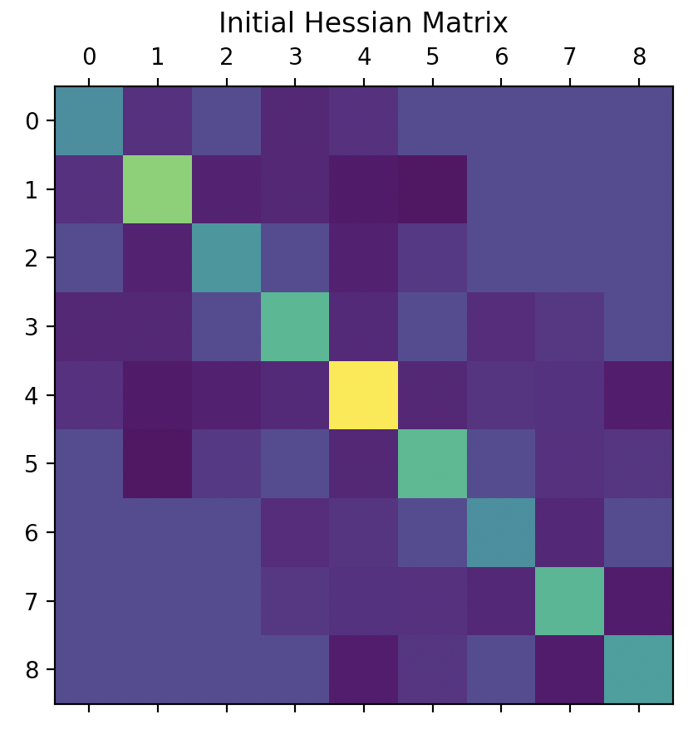
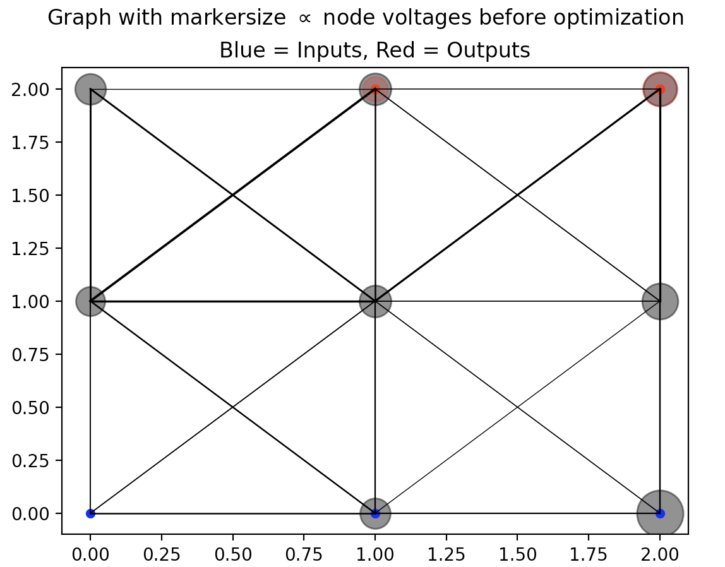
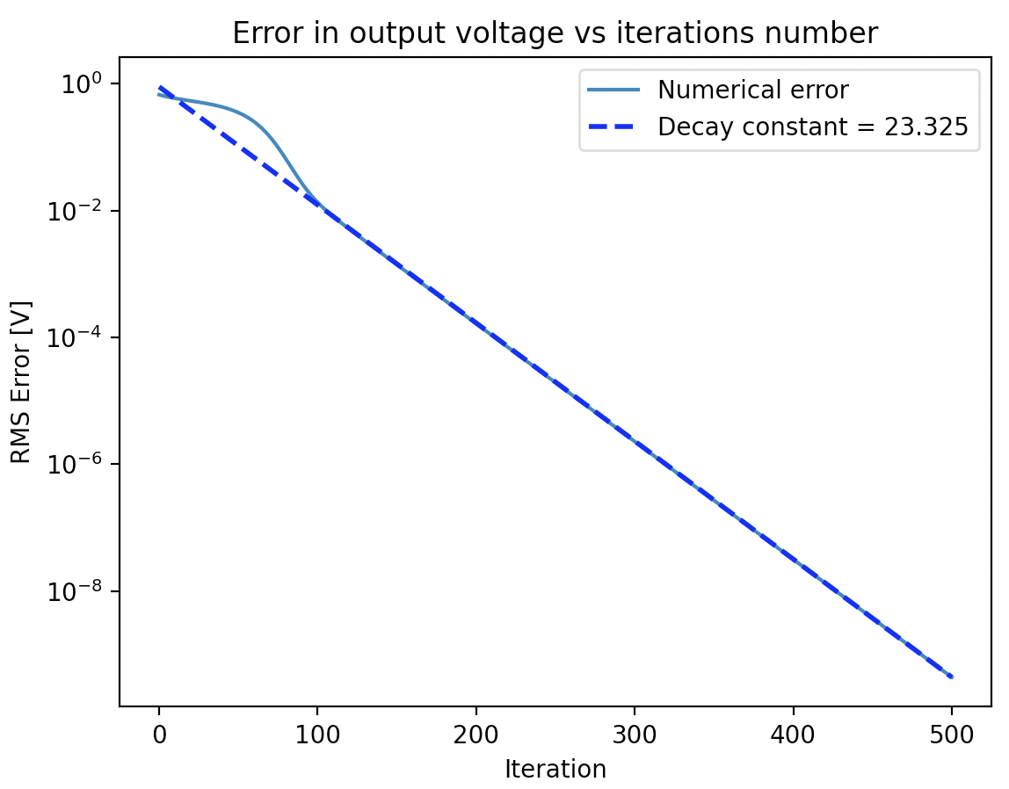
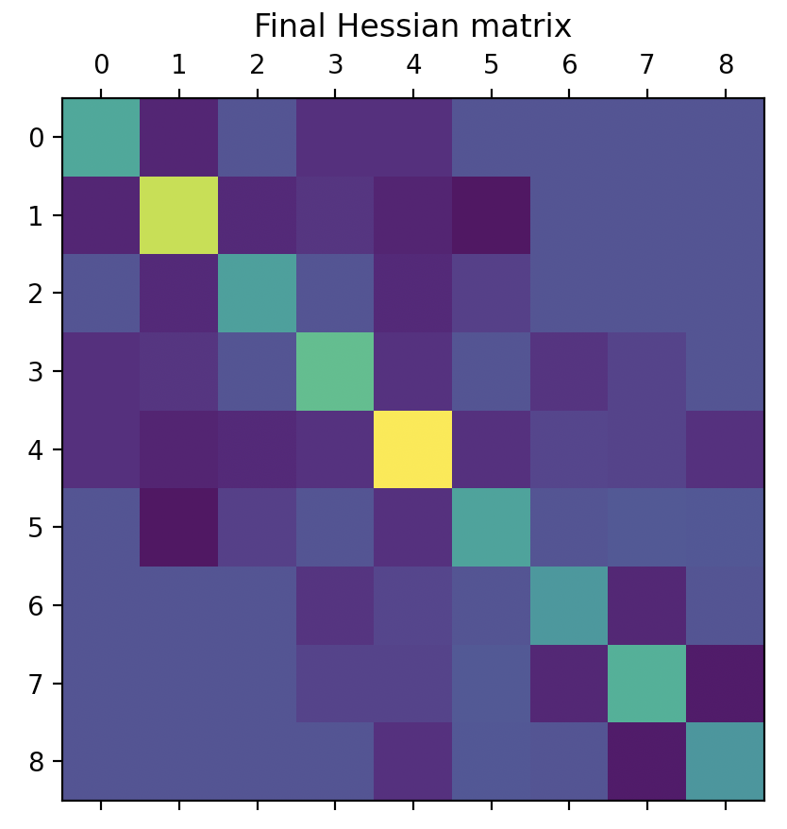
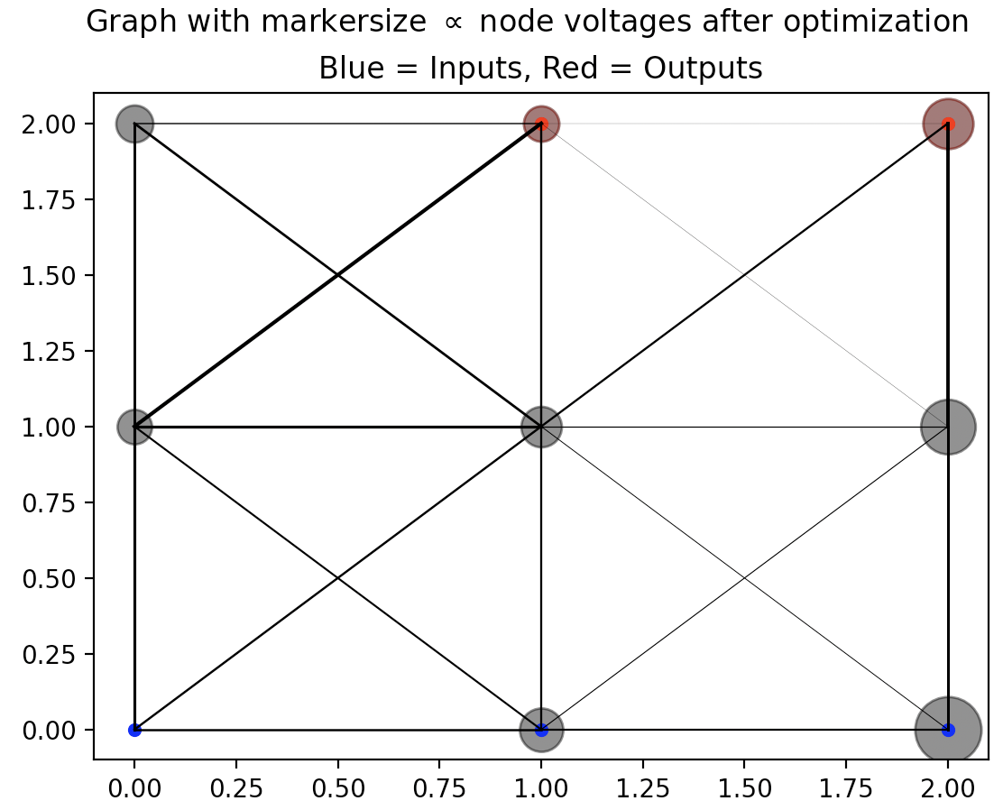
Contrastive learning – some qualitative tests
Change the graph to add next nearest neighbors (diagonals) and repeat --- I observed roughly the same trends, but a faster learning rate at the optimum alpha and eta (alpha ~ eta ~ 0.1, primarily determined by alpha over the range considered)
alpha | eta | decay rate (iterations to decay to 1/e the initial error)
0.5 | 0.5 | 2.33
0.5 | 0.1 | 61.959
0.5 | 0.01 | 23.2
0.1 | 0.5 | 1.1846
0.1 | 0.1 | 1.1863
0.1 | 0.01 | 1.1867
0.01 | 0.5 | 23.185
0.01 | 0.1 | 23.298
0.01 | 0.01 | 23.325

Slide 6
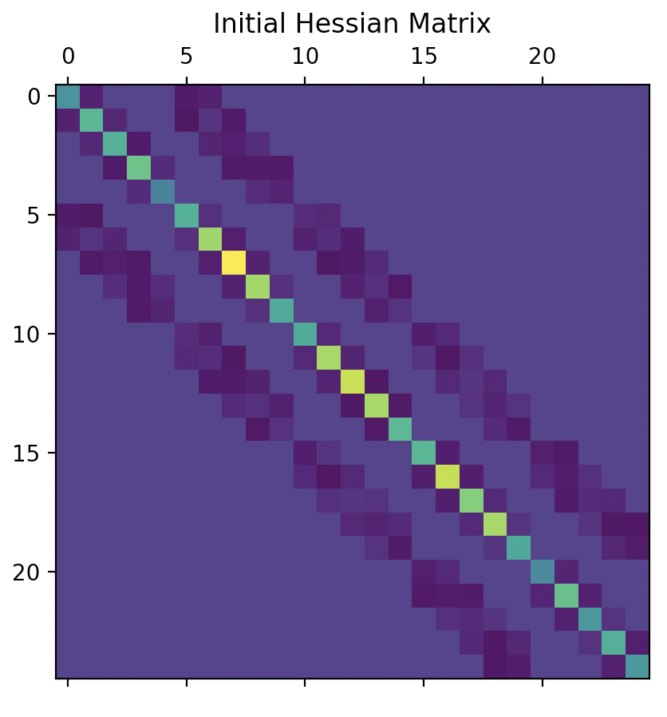
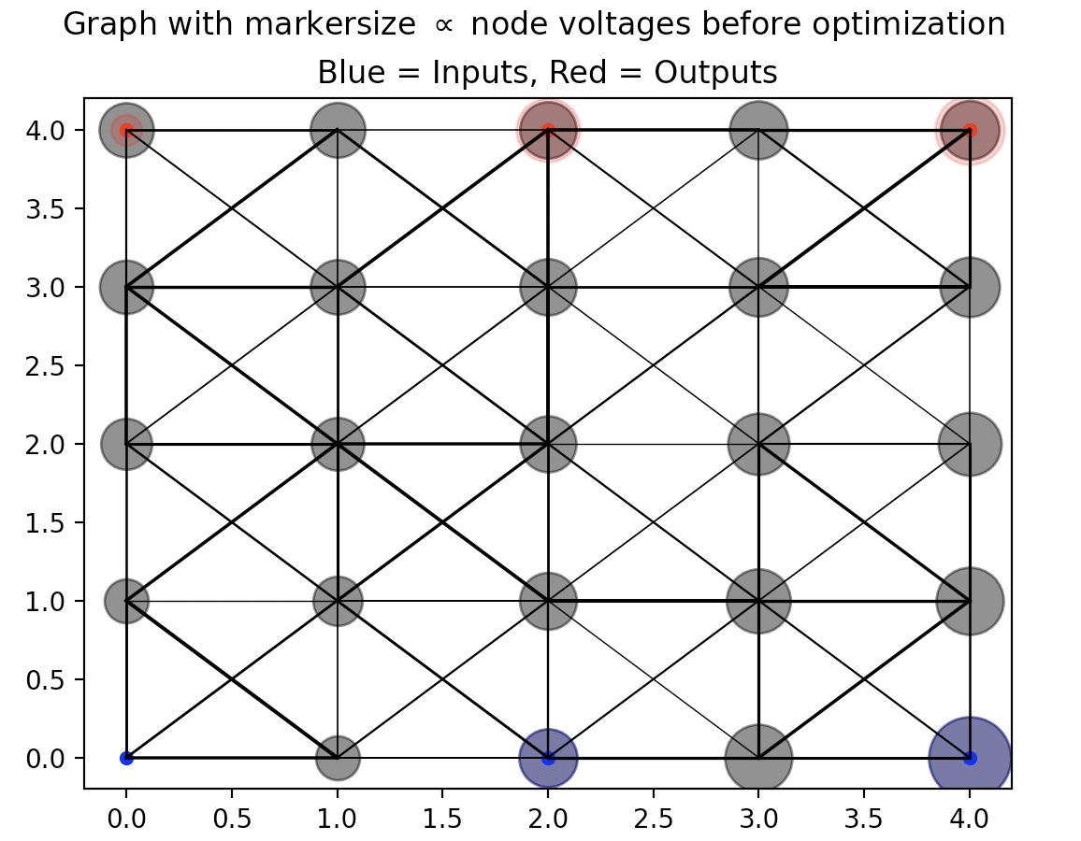
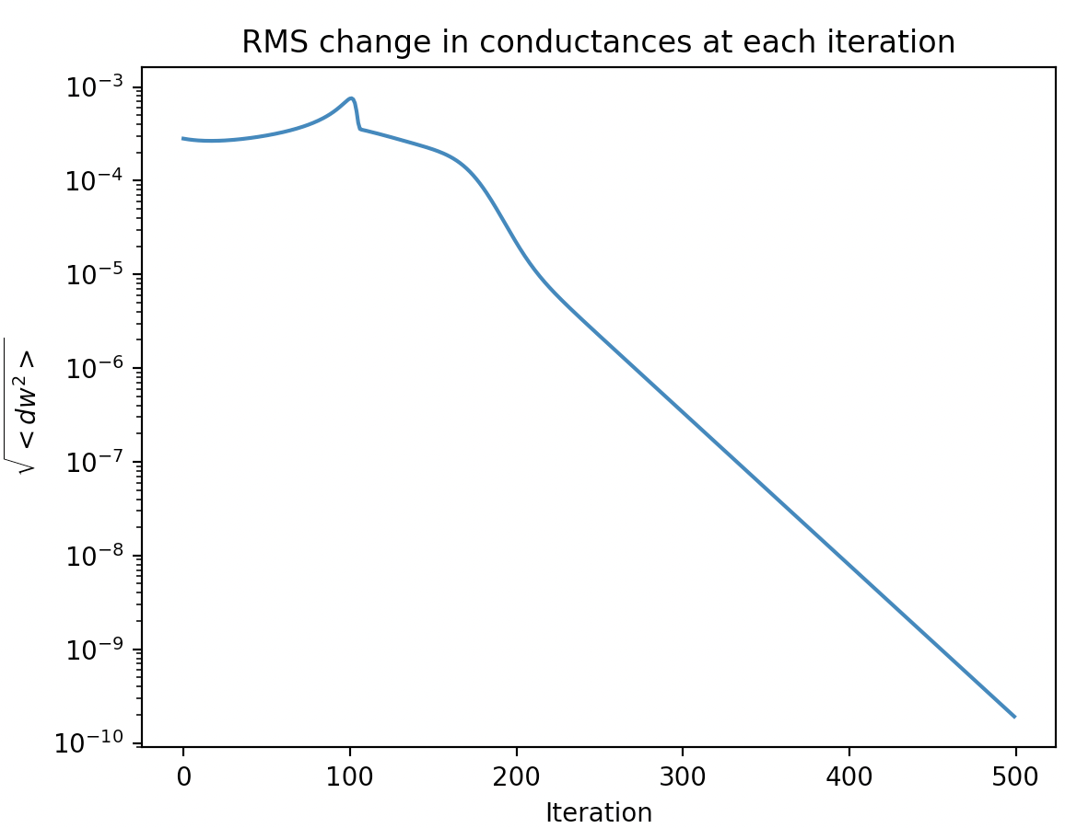
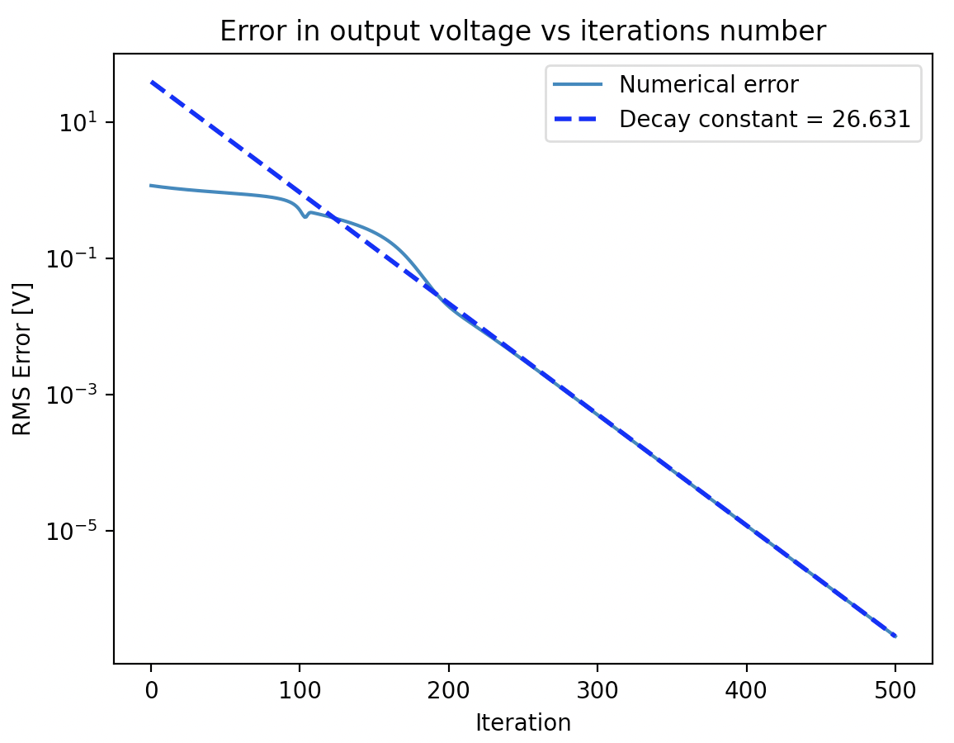
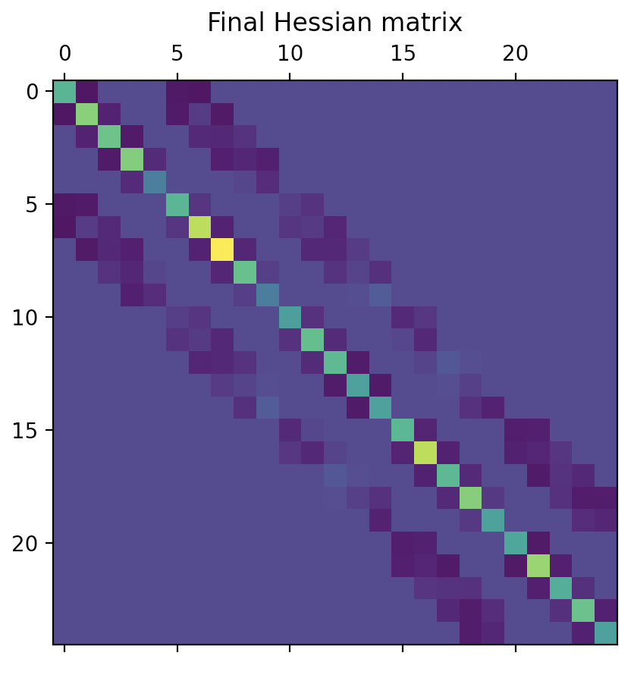
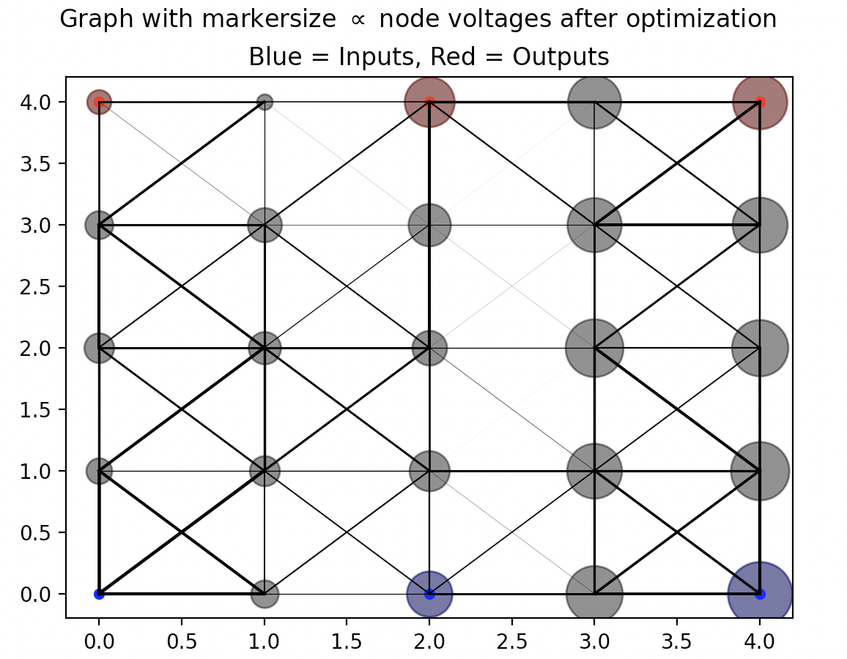
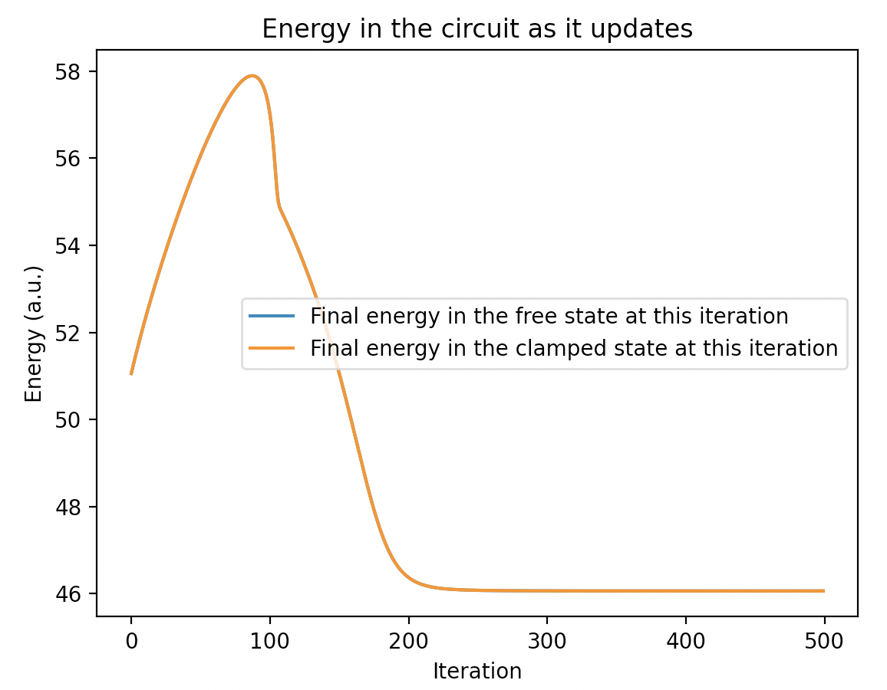
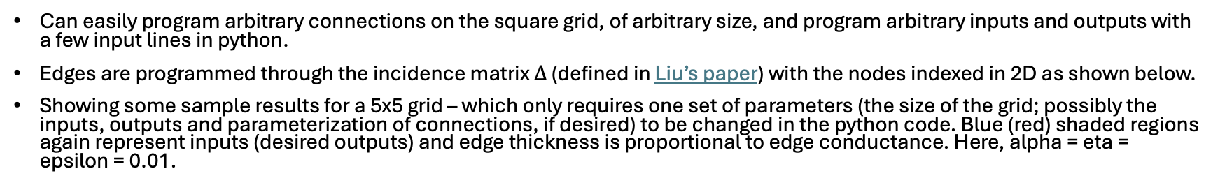
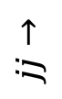
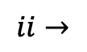
Contrastive learning – larger network
Can easily program arbitrary connections on the square grid, of arbitrary size, and program arbitrary inputs and outputs with a few input lines in python.
Edges are programmed through the incidence matrix $Δ$ (defined in Liu’s paper) with the nodes indexed in 2D as shown below.
Showing some sample results for a 5x5 grid – which only requires one set of parameters (the size of the grid; possibly the inputs, outputs and parameterization of connections, if desired) to be changed in the python code. Blue (red) shaded regions again represent inputs (desired outputs) and edge thickness is proportional to edge conductance. Here, alpha = eta = epsilon = 0.01.
2
5
8
1
4
7
$$jj→$$
0
3
6
$$ii→$$

Slide 7
Conclusions from previous slides
At small alpha (slowly updating the edges), the learning speed is insensitive to the eta (how much the clamped state is nudged).
When the edges are updated more at every iteration (larger alpha), the learning speed becomes sensitive to the nudge given to the clamped state.
More edges allows for faster learning for the same alpha and eta.
The optimum is mainly determined by alpha and was about the same for the initial two 3x3 graphs (alpha ~ 0.1).
Some questions:
How do the magnitudes of w (not just the relative values, which determine the solution) depend on alpha and eta?
How do graph properties (size/radius, cycles, genus, edges/vertex, size of the “Tutte maximizer”^{1, 2}, etc) dictate learning properties (learning rate, learning capacity, etc) for fixed microscopic properties (contrastive learning rule for fixed alpha and eta).
Notes:
See Diestel, Graph Theory, theorem 2.2.3. This is the vertex set S discussed in our meeting, containing a matching edge to every component outside of S.
No name for this set was given in the text – the theorem comes from Tutte’s theorem, and S maximizes some quantity, so I’m calling S the Tutte Maximizer.

Slide 8
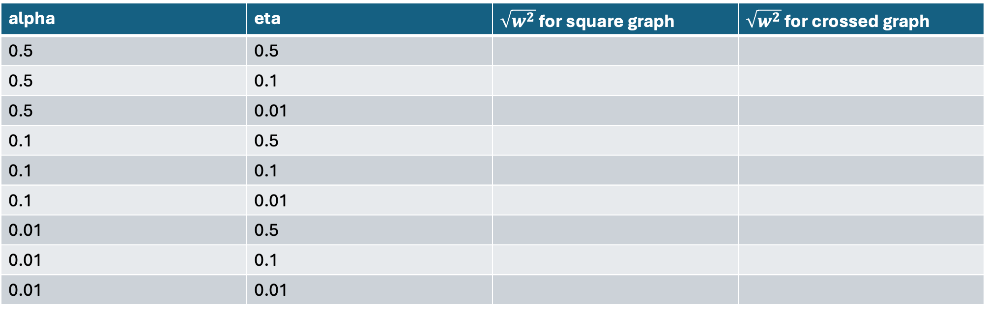
Optimal magnitude of conductance vs alpha and eta
Calculations to be performed later...
alpha | eta | $\sqrt{w^{2}}$ for square graph | $\sqrt{w^{2}}$ for crossed graph
0.5 | 0.5
0.5 | 0.1
0.5 | 0.01
0.1 | 0.5
0.1 | 0.1
0.1 | 0.01
0.01 | 0.5
0.01 | 0.1
0.01 | 0.01

Slide 9
Some questions and procedures investigating the effect of graph structure on learning properties:
How do cycles in the network affect the learning?
Writing a code to find the feedback vertex set¹ (FVS) of a graph, used to eliminate all cycles from a graph, and study how learning properties depend on the number of cycles.
Algorithm for finding the FVS²:
For a connected graph G, find some spanning tree T – a subgraph without cycles that covers every vertex in G. Do so by initializing the root of the graph at some random point and expanding the edges, ensuring no branches meet during the expansion. Results are shown on the next slide.
Erase the edges of T from G.
Find a vertex cover of the remaining edge set³. This gives some FVS. Note the number of vertices in this FVS.
Repeat with a new tree every time and keep the FVS which contains the minimum number of vertices.
How does the number of edge-disjoint paths between nodes in a network influence the synchronized training of properties of those nodes?
A lower bound on the number of distinct paths between any two points can readily be found through counting the number of edge-disjoint spanning trees.
Notes:
1) https://en.wikipedia.org/wiki/Feedback_vertex_set
2) This is my own brute force algorithm, and has no guarantees on optimality or how close it can come to an optimal solution. I expect that it only finds some feedback vertex set that is within a constant factor of the minimal feedback vertex set. There exist better algorithms for finding the FVS.
3) It turns out that the vertex cover problem is NP hard, but a brute force search based on the incidence matrix should be fine for these small case studies.

Slide 10
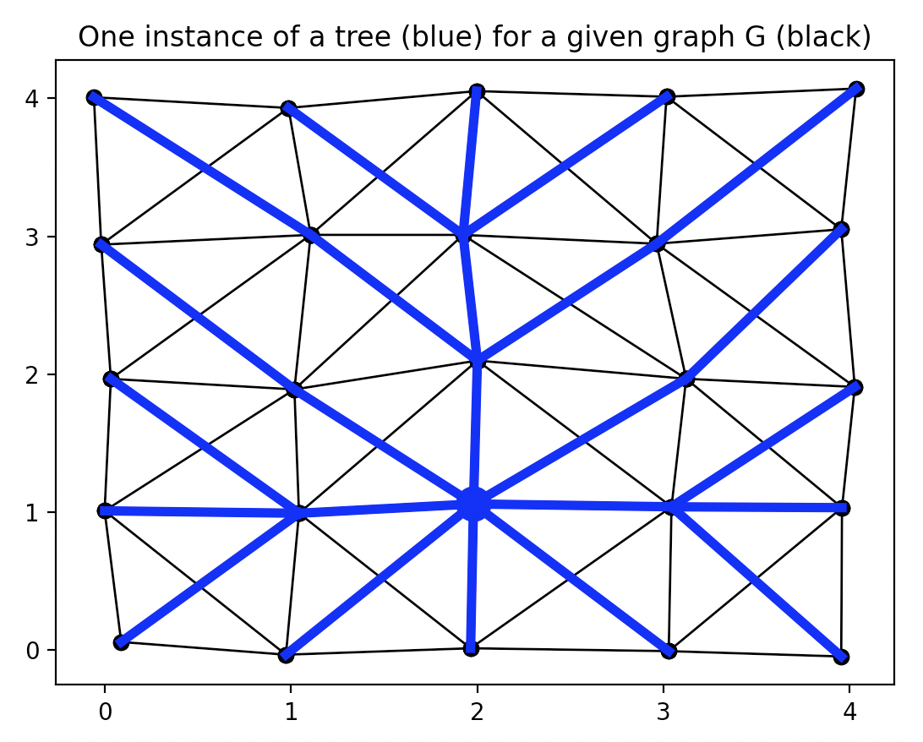
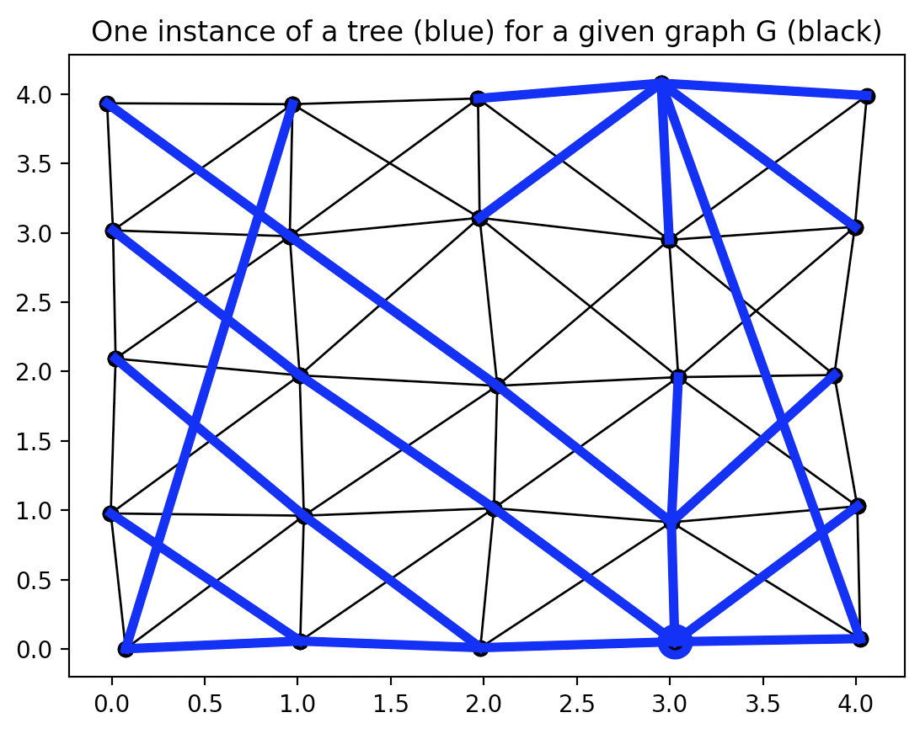
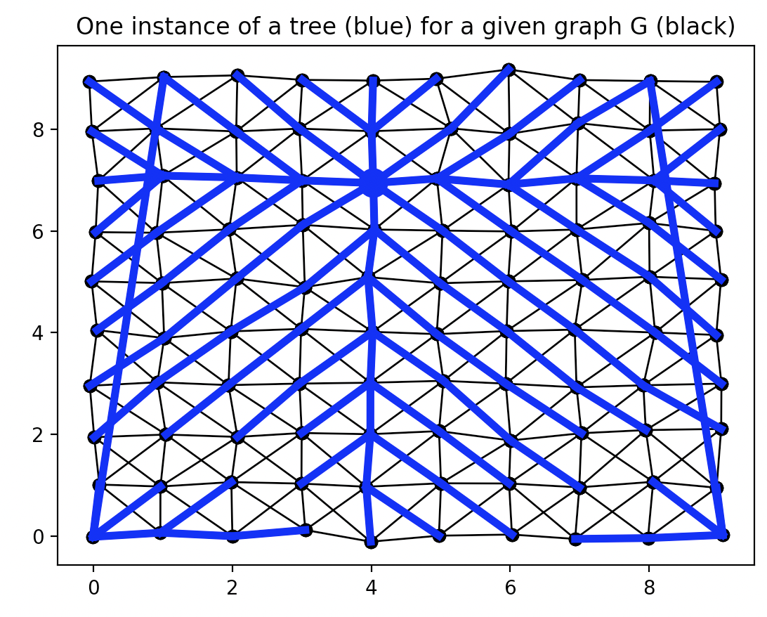
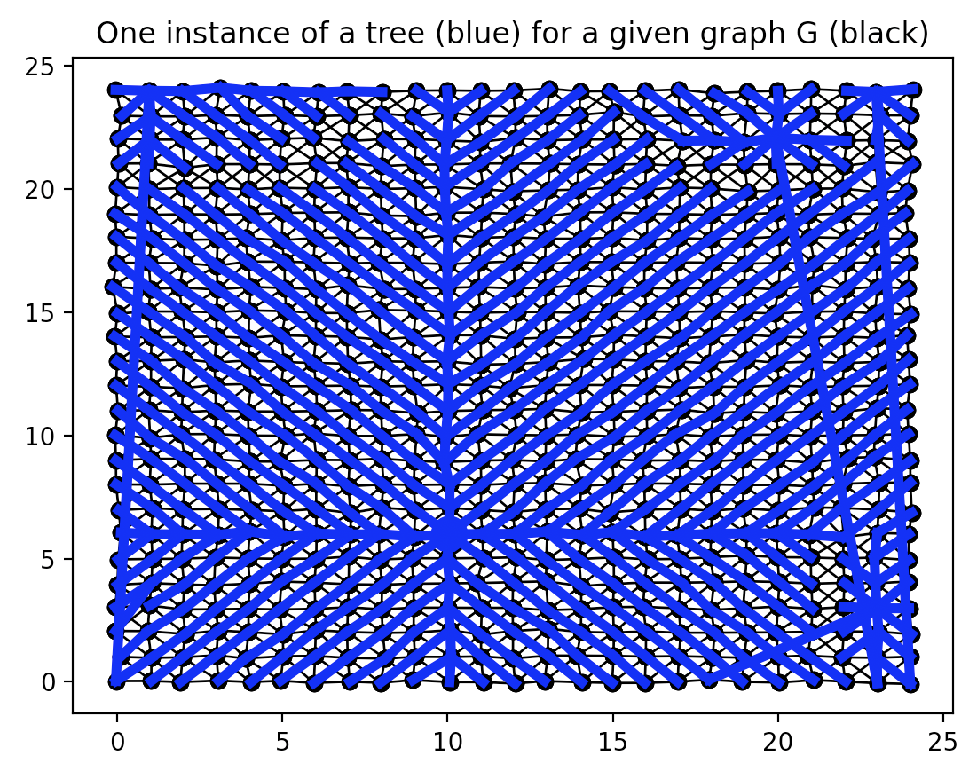
Finding a spanning tree in a graph G
Wrote an algorithm that finds spanning trees in a given graph G.
Below I’m showing a few examples – trees are shown in blue, other edges are shown in black. The positions in the normal square grid are perturbed by a random amount at each node, to make next-nearest neighbors easier to distinguish from nearest neighbors.
Start with 5x5 graph on previous slides
Add some random edges
Make it larger
Add some more random edges and make it larger

